Slide 1
Design And Analysis Of A Helical Gear
CHAPTER 1
INTRODUCTION TO GEARS:
A gear or cogwheel is a rotating machine part having cut teeth, or cogs, which mesh with another toothed part to transmit torque, in most cases with teeth on the one gear being of identical shape, and often also with that shape on the other gear.^{[1]} Two or more gears working in a sequence (train) are called a gear train or, in many cases, a transmission; such gear arrangements can produce a mechanical advantage through a gear ratio and thus may be considered a simple machine. Geared devices can change the speed, torque, and direction of a power source. The most common situation is for a gear to mesh with another gear; however, a gear can also mesh with a non-rotating toothed part, called a rack, thereby producing translation instead of rotation.
The gears in a transmission are analogous to the wheels in a crossed belt pulley system. An advantage of gears is that the teeth of a gear prevent slippage.
When two gears mesh, and one gear is bigger than the other (even though the size of the teeth must match), a mechanical advantage is produced, with the rotational speeds and the torques of the two gears differing in an inverse relationship.
In transmissions with multiple gear ratios—such as bicycles, motorcycles, and cars the term gear, as in first gear, refers to a gear ratio rather than an actual physical gear. The term describes similar devices, even when the gear ratio is continuous rather than discrete, or when the device does not actually contain gears, as in a continuously variable transmission
Definition of gears:
Gears are toothed members which transmit power / motion between two shafts by meshing without any slip. Hence, gear drives are also called positive drives. In any pair of gears, the
smaller one is called pinion and the larger one is called gear immaterial of which is driving the other. When pinion is the driver, it results in step down drive in which the output speed decreases
and the torque increases. On the other hand, when the gear is the driver, it results in step up drive in which the output speed increases and the torque decreases.

Slide 2
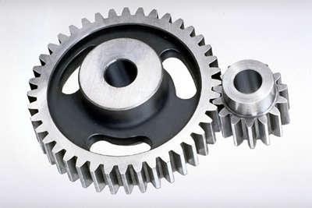
Design And Analysis Of A Helical Gear
Classification Of Gears:
Gears are classified according to the shape of the tooth pair and disposition into spur, helical, double helical, straight bevel, spiral bevel and hypoid bevel, worm and spiral gears and this is
shown in Fig.
Spur gears:
Spur gears have their teeth parallel to the axis Fig and are used for transmitting power between two parallel shafts. They are simple in construction, easy to manufacture and cost less. They have highest efficiency and excellent precision rating. They are used in high speed and high load application in all types of trains and a wide range of velocity ratios. Hence, they find wide applications right from clocks, household gadgets, motor cycles, automobiles, and railways to aircrafts. One such application is shown in Fig.
spur gear

Slide 3
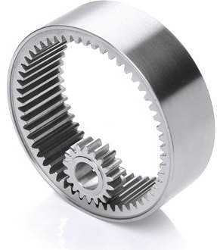
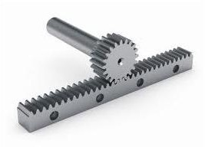
Design And Analysis Of A Helical Gear
internal gears:
Internal gears are used for transmitting power between two parallel shafts. In these gears, annular wheels are having teeth on the inner periphery. This makes the drive very compact Fig In these drives, the meshing pinion and annular gear are running in the same direction
internal gears
Their precision rating is fair. They are useful for high load and high speed application with high reduction ratio. Applications of these gears can be seen in planetary gear drives of automobile automatic transmissions-Fig, reduction gearboxes of cement mills, step-up drives of wind mills. They are not recommended for precision meshes because of design, fabrication, and inspection limitations. They should only be used when internal feature is necessary. However, today precision machining capability has led to their usage even in position devices like antenna drives.
Rack and Pinion:
Rack is a segment of a gear of infinite diameter. The tooth can be spur as in Fig. This type of gearing is used for converting rotary motion into translatory motion or visa versa. Typical example of rack and pinion applications are shown in Figs
Rock and pinion

Slide 4
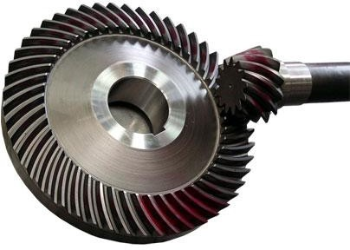
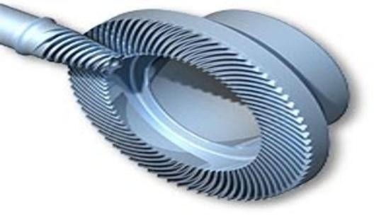
Design And Analysis Of A Helical Gear
Straight Bevel Gear:
Straight bevel gears are used for transmitting power between intersecting shafts, Fig. They can operate under high speeds and high loads. Their precision rating is fair to good. They are suitable
for 1:1 and higher velocity ratios and for right-angle meshes to any other angles. Their good choice is for right angle drive of particularly low ratios.
However, complicated both form and fabrication limits achievement of precision. They should be located at one of the less critical meshes of the train. Wide application of the straight bevel drives is in automotive differentials, right angle drives of blenders and conveyors. A typical application of straight bevel used in differential application is shown in Fig.
Hypoid bevel gear:
These gears are also used for right angle drive in which the axes do not intersect. This permits the lowering of the pinion axis which is an added advantage in automobile in avoiding hump inside the automobile drive line power transmission. However, the non intersection introduces a considerable amount of sliding and the drive requires good lubrication to reduce the friction and wear. Their efficiency is lower than other two types of bevel gears. These gears are widely used in current day automobile drive line power transmission
Hypoid bevel gear

Slide 5
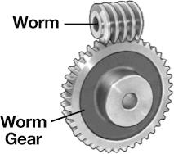
Design And Analysis Of A Helical Gear
Worm Gear :
Worm and worm gear pair consists of a worm, which is very similar to a screw and a worm gear, which is a helical gear as shown in Fig. They are used in right-angle skew shafts. In these gears,
the engagement occurs without any shock. The sliding action prevalent in the system while resulting in quieter operation produces considerable frictional heat. High reduction ratios 8 to
400 are possible.
Efficiency of these gears is low anywhere from 90% to 40 %. Higher speed ratio gears are non- reversible. Their precision rating is fair to good. They need good lubrication for heat dissipation and for improving the efficiency. The drives are very compact.
Spiral gears:
Spiral gears are also known as crossed helical gears, Fig. They have high helix angle and transmit power between two non-intersecting non-parallel shafts. They have initially point contact under the conditions of considerable sliding velocities finally gears will have line contact. Hence, they are used for light load and low speed application such as instruments, sewing machine etc. Their precision rating is poor. An application of spiral gear used in textile machinery is shown in Fig.

Slide 6
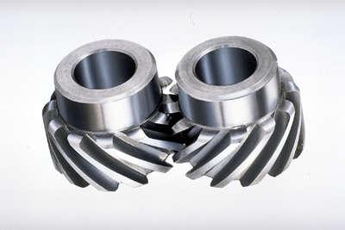
Design And Analysis Of A Helical Gear
CHAPTER 2
Helical gears:
Introduction:
Helical gears are used for parallel shaft drives. They have teeth inclined to the axis as shown in Fig. 1.9. Hence for the same width, their teeth are longer than spur gears and have higher load carrying capacity. Their contact ratio is higher than spur gears and they operate smoother and quieter than spur gears. Their precision rating is good. They are recommended for very high speeds and loads. Thus, these gears find wide applications in automotive gearboxes as illustrated in Fig. 1.10. Their efficiency is slightly lower than spur gears. The helix angle also introduces axial thrust on the shaft.
helical gears

Slide 7
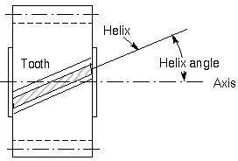
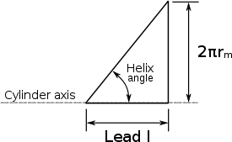
Design And Analysis Of A Helical Gear
Helix angle:
In mechanical engineering, a helix angle is the angle between any helix and an axial line on its right, circular cylinder or cone. Common applications are screws, helical gears, and worm gears.
The helix angle references the axis of the cylinder, distinguishing it from the lead angle, which references a line perpendicular to the axis. Naturally, the helix angle is the geometric complement of the lead angle. The helix angle is measured in degrees.
Helix angle
Concept:
In terms specific to screws, the helix angle can be found by unraveling the helix from the screw, representing the section as a right triangle, and calculating the angle that is formed. Note that while the terminology directly refers to screws, these concepts are analogous to most mechanical applications of the helix angle.

Slide 8

Design And Analysis Of A Helical Gear
The helix angle can be expressed as:
Where
l is lead of the screw or gear
r_{m} is mean radius of the screw thread or gear
Helical or "dry fixed" gears offer a refinement over spur gears. The leading edges of the teeth are not parallel to the axis of rotation, but are set at an angle. Since the gear is curved, this angling makes the tooth shape a segment of a helix. Helical gears can be meshed inparallel or crossed orientations. The former refers to when the shafts are parallel to each other; this is the most common orientation. In the latter, the shafts are non-parallel, and in this configuration the gears are sometimes known as "skew gears".
The angled teeth engage more gradually than do spur gear teeth, causing them to run more smoothly and quietly. With parallel helical gears, each pair of teeth first make contact at a single point at one side of the gear wheel; a moving curve of contact then grows gradually across the tooth face to a maximum then recedes until the teeth break contact at a single point on the opposite side. In skew gears, teeth suddenly meet at a line contact across their entire width causing stress and noise. Spur gears make a characteristic whine at high speeds. Whereas spur gears are used for low speed applications and those situations where noise control is not a problem, the use of helical gears is indicated when the application involves high speeds, large power transmission, or where noise abatement is important. The speed is considered high when the pitch line velocity exceeds 25 m/s.
A disadvantage of helical gears is a resultant thrust along the axis of the gear, which must be accommodated by appropriate thrust bearings, and a greater degree of sliding friction between the meshing teeth—often addressed with additives in the lubricant

Slide 9
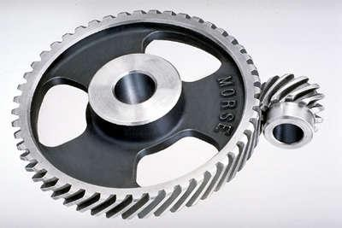
Design And Analysis Of A Helical Gear
Helical gears
The teeth on helical gears are cut at an angle to the face of the gear. When two teeth on a helical gear system engage, the contact starts at one end of the tooth and gradually spreads as the gears rotate, until the two teeth are in full engagement.
This gradual engagement makes helical gears operate much more smoothly and quietly than spur gears. For this reason, helical gears are used in almost all cartransmissions.
Because of the angle of the teeth on helical gears, they create a thrust load on the gear when they mesh. Devices that use helical gears have bearings that can support this thrust load.
One interesting thing about helical gears is that if the angles of the gear teeth are correct, they can be mounted on perpendicular shafts, adjusting the rotation angle by 90 degrees.
Helical gears operate more smoothly and quietly compared to spur gears due to the way the teeth interact. The teeth on a helical gear cut at an angle to the face of the gear. When two of the teeth start to engage, the contact is gradual starting at one end of the tooth and maintaining contact as

Slide 10
Design And Analysis Of A Helical Gear
the gear rotates into full engagement. The typical range of the helix angle is about 15 to 30 deg. The thrust load varies directly with the magnitude of tangent of helix angle. Helical is the most commonly used gear in transmissions. They also generate large amounts of thrust and use bearings to help support the thrust load. Helical gears can be used to adjust the rotation angle by 90 deg. when mounted on perpendicular shafts. Its normal gear ratio range is 3:2 to 10:1.
Whereas spur gears are the most common gears are spur gears and are used in series for large gear reductions. The teeth on spur gears are straight and are mounted in parallel on different shafts. Spur gears are used in washing machines, screwdrivers, windup alarm clocks, and other devices. These are particularly loud, due to the gear tooth engaging and colliding. Each impact makes loud noises and causes vibration, which is why spur gears are not used in machinery like cars. A normal gear ratio range is 1:1 to 6:1.
Mounting Specifications:
Consider the gear center, bore diameter and shaft diameter. The gear center can be a bored hole or an integral shaft. The bore diameter is the diameter of the center hole. The shaft diameter is the diameter of the shaft for gears with an integral shaft. Helical gears can be mounted on a hub or shaft. A hub is a cylindrical projection on one or both sides of a helical gear, often for the provision of a screw or other shaft attachment mechanism. Hubless gears are typically attached via press fit, adhesive or internal keyway.
Helical Gear Accessories:
Due to the gradient of the gear teeth and the pressure applied to the teeth, helical gears are prone to misalignment by axial thrust. This can be remedied by the use of thrust bearings and high- pressure lubricant. If the operation cannot use thrust bearings, herringbone gears may be an alternative.

Slide 11
Design And Analysis Of A Helical Gear
Helical Gear Materials:
Gear composition is determined by application, including the gear's service, rotation speed, accuracy and more.
Cast iron provides durability and ease of manufacture.
Alloy steel provides superior durability and corrosion resistance. Minerals may be added to the alloy to further harden the gear.
Cast steel provides easier fabrication, strong working loads and vibration resistance.
Carbon steels are inexpensive and strong, but are susceptible to corrosion.
Aluminum is used when low gear inertia with some resiliency is required.
Plastic is inexpensive, corrosion resistant, quiet operationally and can overcome missing teeth or misalignment. Plastic is less robust than metal and is vulnerable to temperature changes and chemical corrosion. Acetal, delrin, nylon, and polycarbonate plastics are common.
Other material types like wood may be suitable for individual applications.
Helical Gear Applications:
Application requirements should be considered with the workload and environment of the gear set in mind.0
Power, velocity and torque consistency and output peaks of the gear drive so the gear meets mechanical requirements.
Inertia of the gear through acceleration and deceleration. Heavier gears can be harder to stop or reverse.
Precision requirement of gear, including gear pitch, shaft diameter, pressure angle and tooth layout. Helical gears' precise teeth can make them expensive
Handedness (left or right teeth angles) depending the drive angle.
Gear lubrication requirements. Some gears require lubrication for smooth, temperate operation and this is especially true for helical gears.
Mounting requirements. Application may limit the gear's shaft positioning.

Slide 12
Design And Analysis Of A Helical Gear
Noise limitation. Commercial applications may value a smooth, quietly meshing gear. Helical gears offer quiet operation.
Corrosive environments. Gears exposed to weather or chemicals should be especially hardened or protected.
Application requirements should be considered with the workload and environment of the gear set in mind.
Power, velocity and torque consistency and output peaks of the gear drive so the gear meets mechanical requirements.
Inertia of the gear through acceleration and deceleration. Heavier gears can be harder to stop or reverse.
Precision requirement of gear, including gear pitch, shaft diameter, pressure angle and tooth layout. Helical gears' precise teeth can make them expensive
Handedness (left or right teeth angles) depending the drive angle.
Gear lubrication requirements. Some gears require lubrication for smooth, temperate operation and this is especially true for helical gears.
Mounting requirements. Application may limit the gear's shaft positioning.
Noise limitation. Commercial applications may value a smooth, quietly meshing gear. Helical gears offer quiet operation.
Corrosive environments. Gears exposed to weather or chemicals should be especially hardened or protected.
Temperature exposure. Some gears may warp or become brittle in the face of extreme temperatures.
Advantages:
Useful for high speed and high power applications, quiet at high speeds. Often used instead of spur gears for high speed applications
Disadvantages:
Generate a thrust load on a single face, more expensive than spur gears.

Slide 13
Design And Analysis Of A Helical Gear
CHAPTER 3
3.1 Introduction to composite materials:
Composite materials have been widely used to improve the performance of various types of structures. Compared to conventional materials, the main advantages of composites are their superior stiffness to mass ratio as well as high strength to weight ratio. Because of these advantages, composites have been increasingly incorporated in structural components in various industrial fields. Some examples are helicopter rotor blades, aircraft wings in aerospace engineering, and bridge structures in civil engineering applications. Some of the basic concepts of composite materials are discussed in the following section to better acquaint ourselves with the behavior of composites.
Selection of Material:
Based on the advantages discussed above, the high strength and high modulus aluminum silicon carbide materials are selected for composite drive shaft. the properties of the aluminum silicon carbide material used for composite drive shaft.
Aluminum alloy materials or simply composites are combinations of materials. They are made up of combining two or more materials in such a way that the resulting materials have certain design properties or improved properties. Aluminum Silicon carbide alloy composite materials are widely used for a many number of applications like engineering structures, industry and electronic applications, sporting goods and so on. The properties of aluminum metal matrix composite mostly depend on the processing method which is capable of producing good properties to comply the industry need. Al-SiC composites can be more easily produced by the stir casting technique due to its good cast ability and relatively inexpensive.
Preparation of aluminum silicon carbide:
Preparation of Aluminum-Silicon Carbide Composite Casting is probably one of the most ancient processes of manufacturing metallic components. The metal matrix composite used in the present work is prepared by the stir casting method. For the preparation of the Aluminum silicon carbide composite by using stir casting mass basis ratio of 100:2.5, 100:5, 100:7.5, and

Slide 14
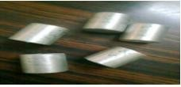
Design And Analysis Of A Helical Gear
100:10 are taken. Fig. 1 illustrates the raw materials and samples of Aluminum Silicon Carbide material. Aluminum alloy in the form of ingots is used. The metal ingots are cleaned and melted to the desired super heating temperature of 750o C in graphite crucibles. Fig.2 shows schematic set up for stir casting technique. A three-phase electrical resistance furnace with temperature controlling device is used for melting. For each melting 300 - 400 g of alloy is used. The super heated molten metal is degassed at a temperature of 780o C. SiC particulates, preheated to around 500o C, are then added to the molten metal and stirred continuously by a mechanical stirrer at 720o C. The stirring time is between 5 and 8 minutes. During stirring, Borax powder was added in small quantities to increase the wet ability of Sic particles.
Raw materials and Samples of Aluminum Silicon Carbide material

Slide 15
Design And Analysis Of A Helical Gear
CHAPTER 4
4.1 SOLID WORKS
Solid Works is mechanical design automation software that takes advantage of the familiar Microsoft Windows graphical user interface.
It is an easy-to-learn tool which makes it possible for mechanical designers to quickly sketch ideas, experiment with features and dimensions, and produce models and detailed drawings.
A Solid Works model consists of parts, assemblies, and drawings.
Typically, we begin with a sketch, create a base feature, and then add more features to the model. (One can also begin with an imported surface or solid geometry).
We are free to refine our design by adding, changing, or reordering features.
Associatively between parts, assemblies, and drawings assures that changes made to one view are automatically made to all other views.
We can generate drawings or assemblies at any time in the design process.
The Solid works software lets us customize functionality to suit our needs.
Introduction To Solid Works:
Solid works mechanical design automation software is a feature-based, parametric solid modeling design tool which advantage of the easy to learn windows TM graphical user interface. We can create fully associate 3-D solid models with or without while utilizing automatic or user defined relations to capture design intent.
Parameters refer to constraints whose values determine the shape or geometry of the model or assembly. Parameters can be either numeric parameters, such as line lengths or circle diameters, or geometric parameters, such as tangent, parallel, concentric, horizontal or vertical, etc. Numeric parameters can be associated with each other through the use of relations, which allow them to capture design intent.
Design intent is how the creator of the part wants it to respond to changes and updates. For example, you would want the hole at the top of a beverage can to stay at the top surface,

Slide 16
Design And Analysis Of A Helical Gear
regardless of the height or size of the can. Solid Works allows you to specify that the hole is a feature on the top surface, and will then honor your design intent no matter what the height you later gave to the can. several factors contribute to how we capture design intent are Automatic relations, Equations, added relations and dimensioning.
Features refer to the building blocks of the part. They are the shapes and operations that construct the part. Shape-based features typically begin with a 2D or 3D sketch of shapes such as bosses, holes, slots, etc. This shape is then extruded or cut to add or remove material from the part. Operation-based features are not sketch-based, and include features such as fillets, chamfers, shells, applying draft to the faces of a part, etc.
Building a model in Solid Works usually starts with a 2D sketch (although 3D sketches are available for power users). The sketch consists of geometry such as points, lines, arcs, conics (except the hyperbola), and spines. Dimensions are added to the sketch to define the size and location of the geometry. Relations are used to define attributes such as tangency, parallelism, perpendicularity, and concentricity. The parametric nature of Solid Works means that the dimensions and relations drive the geometry, not the other way around. The dimensions in the sketch can be controlled independently, or by relationships to other parameters inside or outside of the sketch.
Several ways a part can be builded like
Layer-cake approach :
The layer-cake approach builds the part one piece at a time ,adding each layer, or feature, onto the previous one.
Potter’s wheel approach :
The potter’s wheel approach builds the part as a single revolved feature.As a single sketch representing the cross section includes all the information and dimensions necessary to make the part as one feature.

Slide 17
Design And Analysis Of A Helical Gear
3. Manufacturing approach :
The manufacturing approach to modeling mimics the way the part would be manufactured. For example ,if the stepped shaft was turned a lathe ,we would start with a piece of bar stock and remove material using a series of cuts.
In an assembly, the analogue to sketch relations is mates. Just as sketch relations define conditions such as tangency, parallelism, and concentricity with respect to sketch geometry, assembly mates define equivalent relations with respect to the individual parts or components, allowing the easy construction of assemblies. Solid Works also includes additional advanced mating features such as gear and cam follower mates, which allow modeled gear assemblies to accurately reproduce the rotational movement of an actual gear train.
Finally, drawings can be created either from parts or assemblies. Views are automatically generated from the solid model, and notes, dimensions and tolerances can then be easily added to the drawing as needed. The drawing module includes most paper sizes and standards.
A Solid Works model consists of parts, assemblies, and drawings.
Part: Individual components are drawn in the form of part drawings.
Assembly: The individual parts are assembled in this region.
Drawings: This contains detailed information of the assembly.
History Of Solid Works:
Solid Works Corporation was founded in December 1993 by Massachusetts Institute of Technology graduate Jon Hirschtick; Hirschtick used $1 million he had made while a member of the MIT Blackjack Team to set up the company. Initially based in Waltham, Massachusetts, USA, Hirschtick recruited a team of engineers with the goal of building 3D CAD software that was easy-to-use, affordable, and available on the Windows desktop. Operating later from Concord, Massachusetts, Solid Works released its first product Solid Works 95, in 1995. In 1997 Dassault, best known for its CATIA CAD software, acquired Solid Works for $310 million in stock.

Slide 18
Design And Analysis Of A Helical Gear
Solid Works currently markets several versions of the Solid Works CAD software in addition to eDrawings, a collaboration tool, and DraftSight, a 2D CAD product.
Solid Works was headed by John McEleney from 2001 to July 2007 and Jeff Ray from 2007 to January 2011. The current CEO is Bertrand Sicot.
SOLID WORKS 3-D MECHANICAL DESIGN APPLICATIONS:
Solid works Standard Solid works Professional
Solid works Premium: provides a suite of product development tools mechanical design, design verification, data management, and communication tools. Solid works Premium includes all of the capabilities of Solid works Professional as well as routing and analysis tools, including Solid works Routing, Solid works Simulation, and Solid works Motion.
Solid works Education Edition: provides the same design functionality but is configured and packaged for engineering and industrial design students.
Design Validation Tools:
Solid works Simulation is a design validation tool that shows engineers how their designs will behave as physical objects.
Solid works Motion is a virtual prototyping tool that provides motion simulation capabilities to ensure designs function properly.
Solid works Flow Simulation is a tool that tests internal and external fluid-flow simulation and thermal analysis so designers can conduct tests on virtual prototypes.
Solid works Simulation Premium is a Finite Element Analysis (FEA) design validation tool that can handle some multiphysics simulations as well as nonlinear materials.

Slide 19
Design And Analysis Of A Helical Gear
Product Data Management Tools:
Solid works Workgroup PDM is a PDM tool that allows Solid works users operating in teams of 10 members or less to work on designs concurrently. With Solid works PDM Workgroup, designers can search, revise, and vault CAD data while maintaining an accurate design history.
Solid works Enterprise PDM is a PDM tool that allows Solid works users operating in teams at various separate facilities to work on designs concurrently. With Solid works Enterprise PDM, designers can search, revise, and vault CAD data while maintaining an accurate design history. Enterprise PDM maintains an audit trail, is compatible with a variety of CAE packages (Auto Desk, Siemens, PTC, Catia, etc.) to maintain interfile relations, and will manage the revisions of any document saved in the vault. Enterprise PDM also uses a workflow diagram to automatically notify team members when a project moves from one stage to the next, as well as tracking comments. Enterprise PDM is capable of interfacing with various MRP/ERP systems and can be used online to interface with customers and the supply chain.
Design Communication And Collaboration Tools:
eDrawings Professional :An e-mail-enabled communication tool for reviewing 2D and 3D product design data across the extended product development team. eDrawings generates accurate representations of DWG gateway is a free data translation tool that enables any AutoCAD software user to open and edit any DWG file, regardless of the version of AutoCAD it was made in.
Mobile eDrawings
Solid works Viewer: is a free plug-in for viewing Solid works parts, assemblies, and drawings.
'3DVIA Composer', now known as 'Solid works Composer', is a technical communications software that allows 3D views of models to be integrated into documents such as work instructions, internal or external manuals, marketing materials, or web applications. The 3D

Slide 20
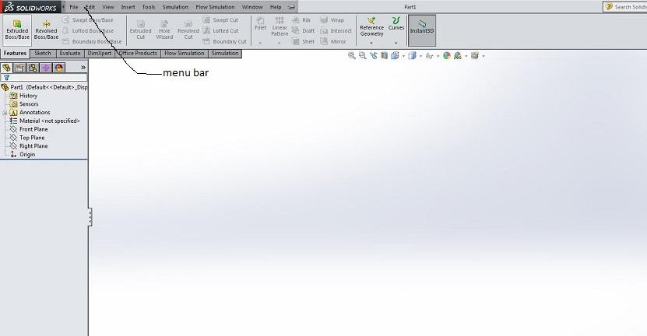
Design And Analysis Of A Helical Gear
views can be updated automatically when the design updates, reducing the workload of the employee creating the technical document, as editing for changes is not as severe.
Cad Productivity Tools:
Solid works Toolbox is a library of parts that uses "Smart Part" Technology to automatically select fasteners and assemble them in the desired sequence.
Solid works Utilities is software that lets designers find differences between two versions of the same part, or locate, modify, and suppress features within a model.
Feature Works is feature recognition software that lets designers make changes to static geometric data, increasing the value of translated files. With Feature Works, designers can preserve or introduce new design intent when bringing 3D models created in other software into the Solid works environment.
SOLID WORKS INTERFACE:
Figure 15 :solid works interface

Slide 21



Design And Analysis Of A Helical Gear
Feature bar:
Figure 16 : feature bar
Some of the features are:
1. Extrude feature :
once the sketch is completed ,it can be extruded to create the first feature
. This feature can be a base, boss or cut feature
2. Revolve feature :
The revolve options enables us to create a feature from an axis symmetric sketch and an axis. This feature can be a base, boss or cut feature..The axis can be centerline, line, liner edge, axis or temporary axis.

Slide 22


Design And Analysis Of A Helical Gear
Swept feature :
sweep creates feature fro m two sketches : a sweep section and sweep path. The section is moved along the path, creating the feature.
Loft feature :
Loft creates a feature by making transitions between profiles. A loft can be a base, boss, cut, or surface. This feature can be a base, boss or cut feature.
Boundary feature :
Boundary tools produces very high quality, accurate features useful for creating complex shapes for markets focused on consumer product design, medical, aerospace, and molds.
Fillet feature :
Fillet/Round creates a rounded internal or external face on the part. You can fillet all edges of a face, selected sets of faces, selected edges, or edge loops.
7. Pattern feature :
Patterns are the best method for creating multiple instances of one feature or more features. some of types of patterns are Linear, circular, mirror, table driven, sketch driven
,curve driven and fill driven.

Slide 23
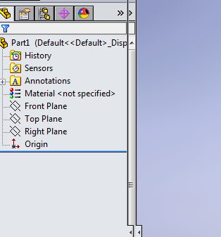
Design And Analysis Of A Helical Gear
Feature Manager Design Tree:
Figure 17 : feature manager design tree
The Feature Manager design tree on the left side of the Solid works window provides an outline view of the active part, assembly, or drawing. This makes it easy to see how the model or assembly was constructed or to examine the various sheets and views in a drawing.
Property Manager In Feature Manager Design Tree :
The Property Manager is a means to set properties and other options for many Solid
works commands. The Property Manager appears on the Property Manager tab in the panel to the left of the graphics area. It opens when you select entities or commands defined in the Property Manager.
Modeling of helical gear:
Draw a sketch as following

Slide 24
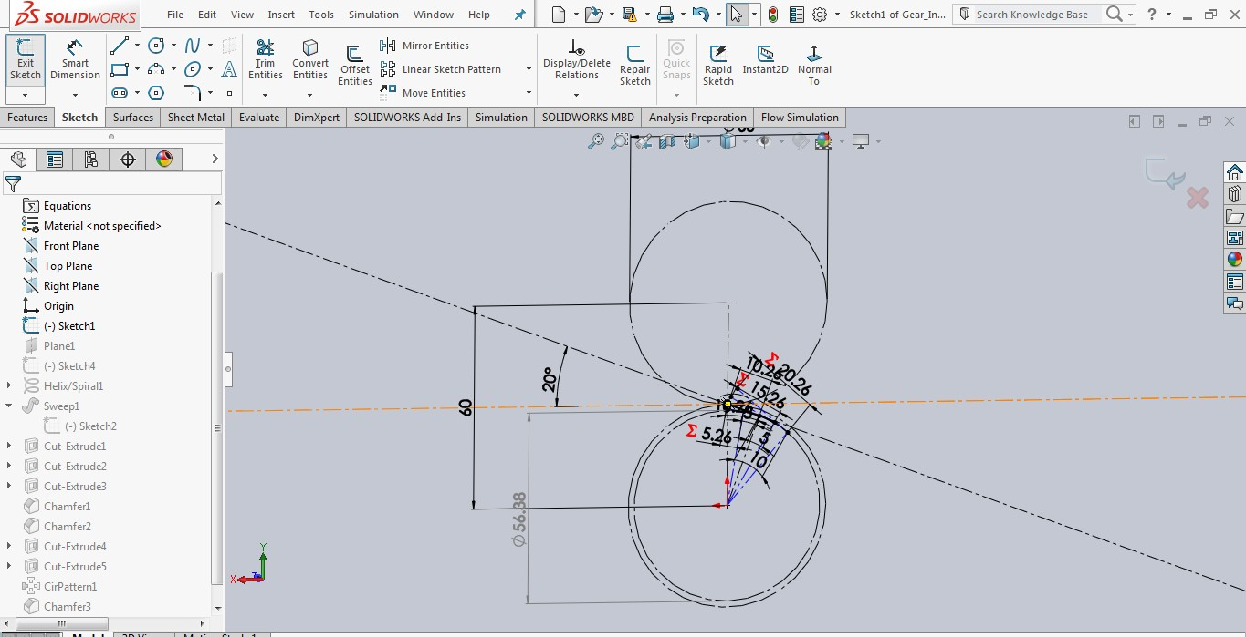
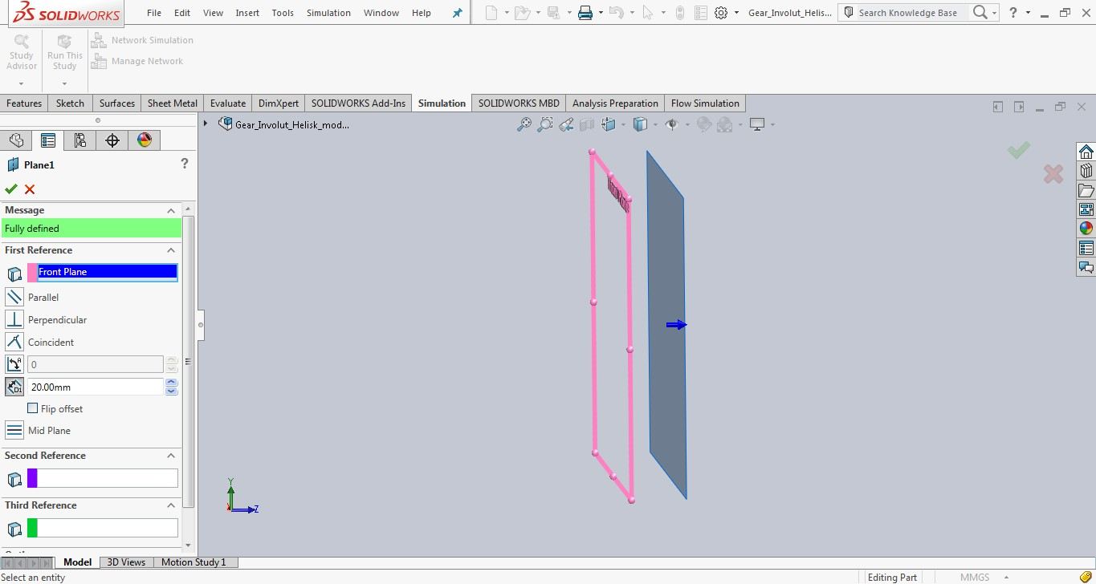
Design And Analysis Of A Helical Gear
First select a reference plane as following:

Slide 25
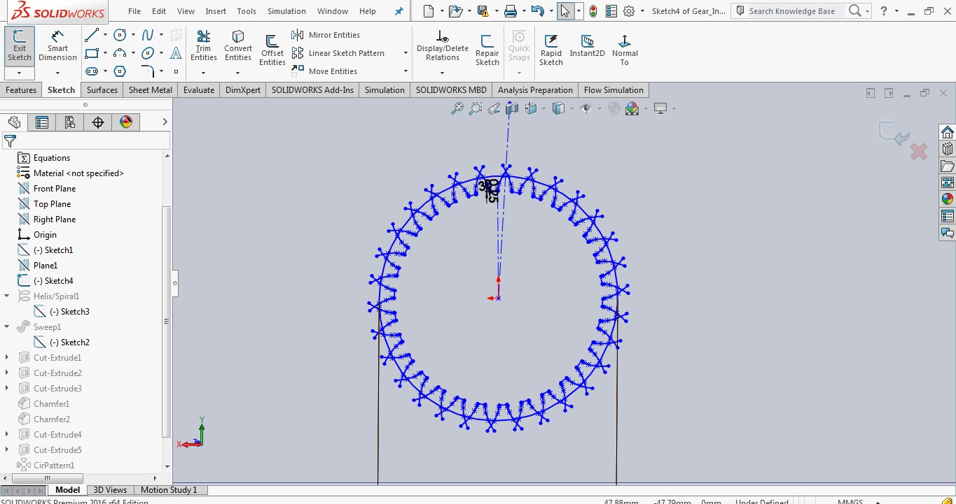
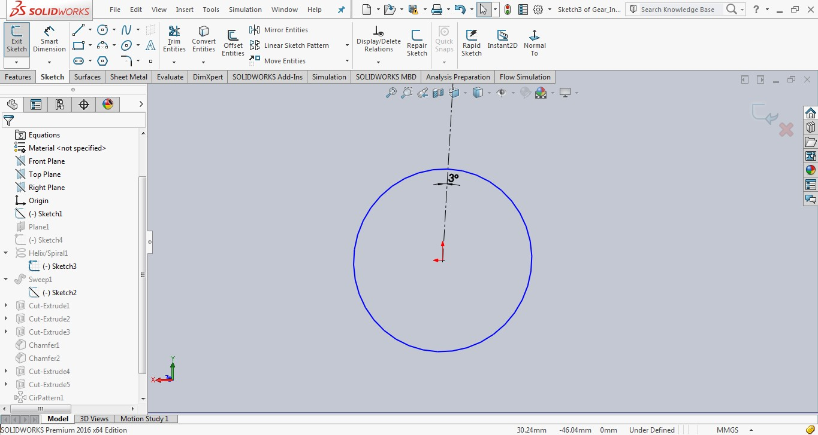
Design And Analysis Of A Helical Gear
Then draw a sketch as follows
Draw another sketch of circle
Then use the helix and spiral in curves in features

Slide 26
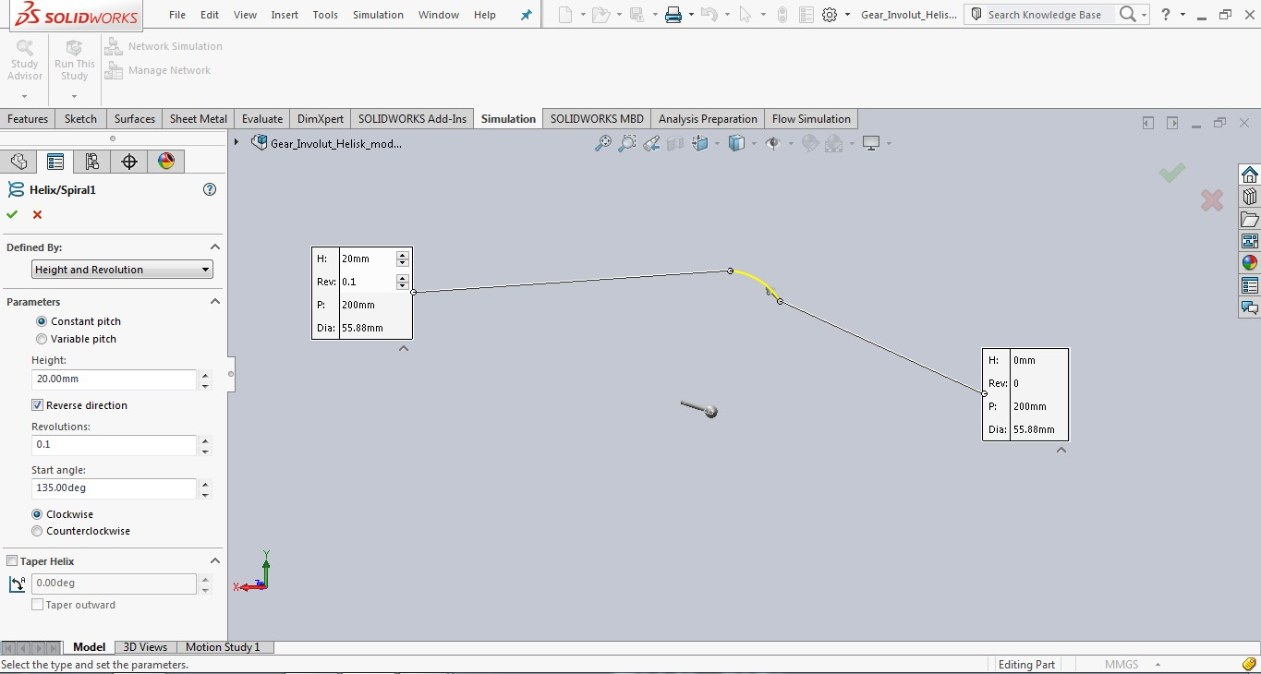
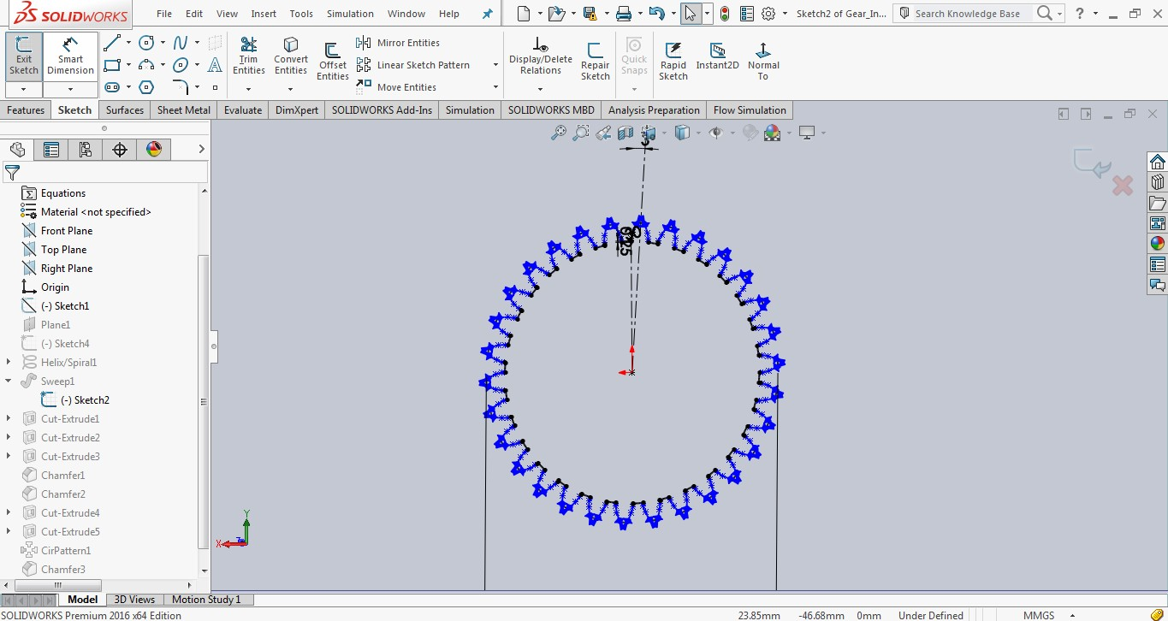
Design And Analysis Of A Helical Gear
Then draw a sketch as follows and sweep it in features

Slide 27
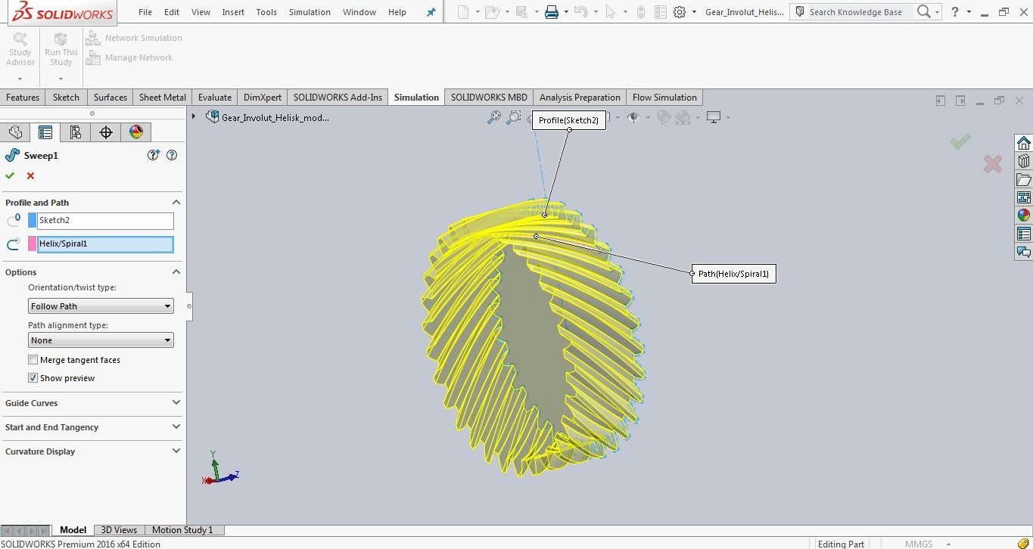
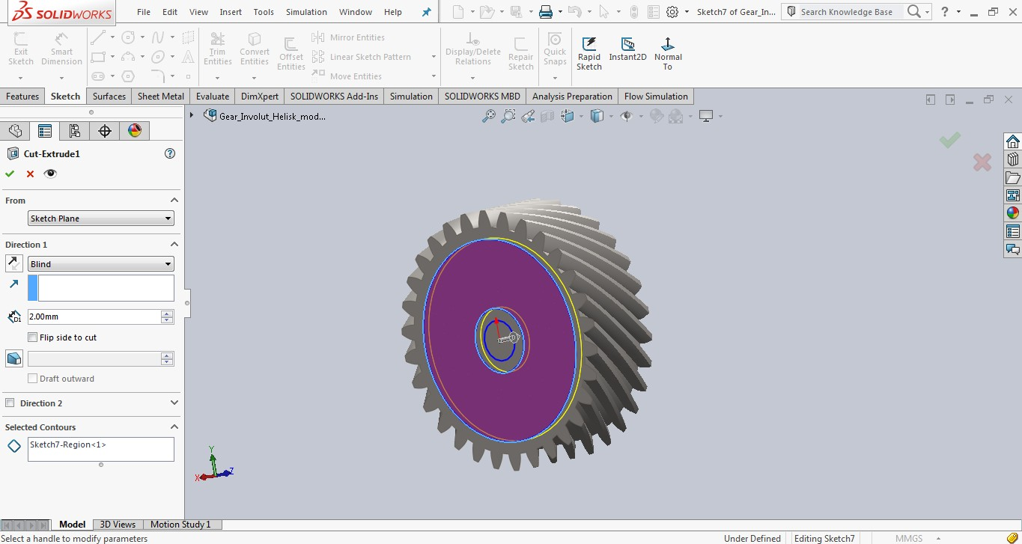
Design And Analysis Of A Helical Gear
Then after sweep draw a sketch as follows and make cut extrude in features
Make another cut extrude to the following sketch by using extrude cut option in features

Slide 28
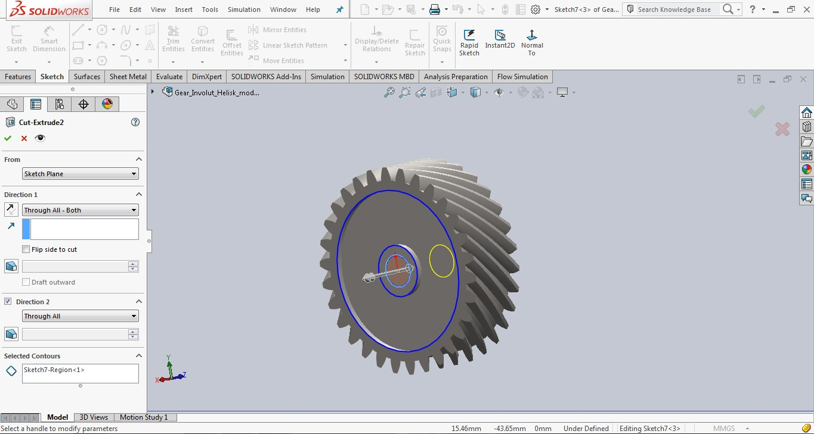
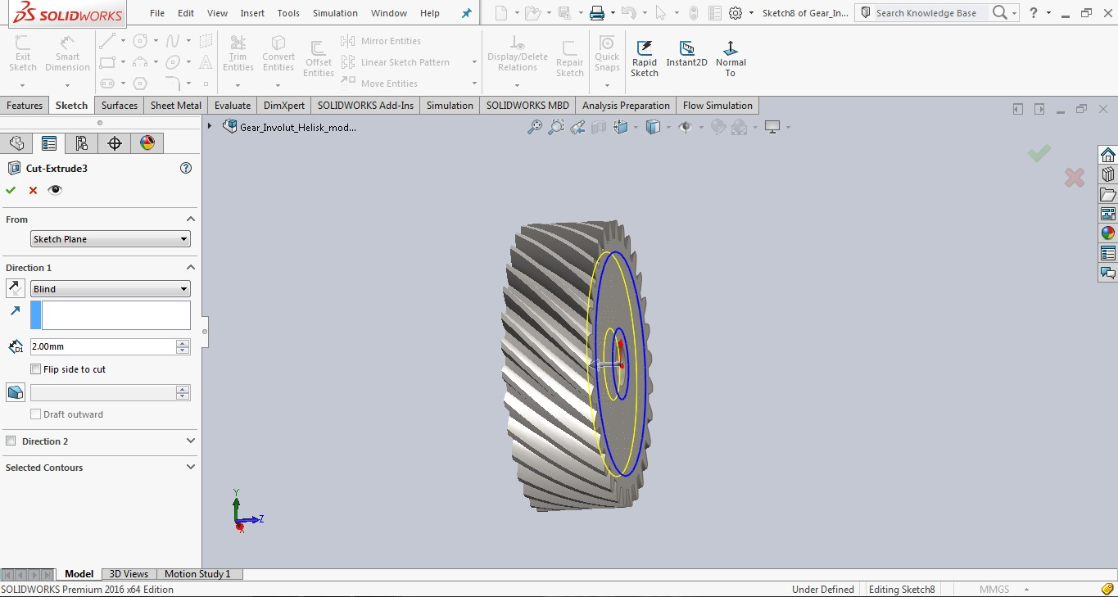
Design And Analysis Of A Helical Gear
Make another cut extrude to following sketch as follows
Give chamfers wherever required
And make another extrude cut to the following sketch

Slide 29
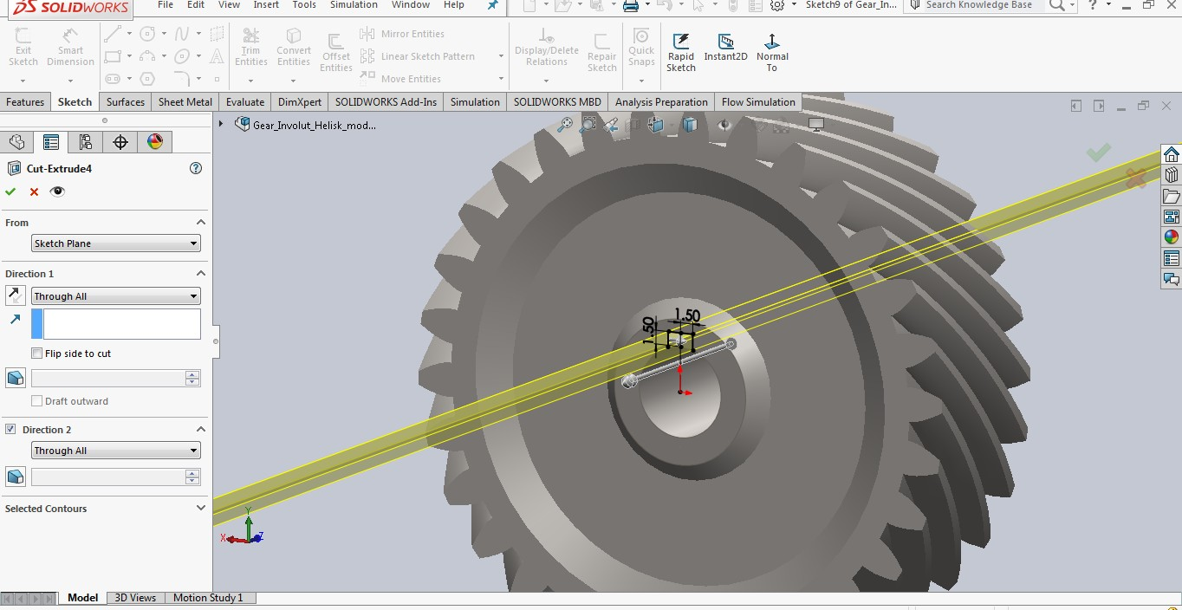
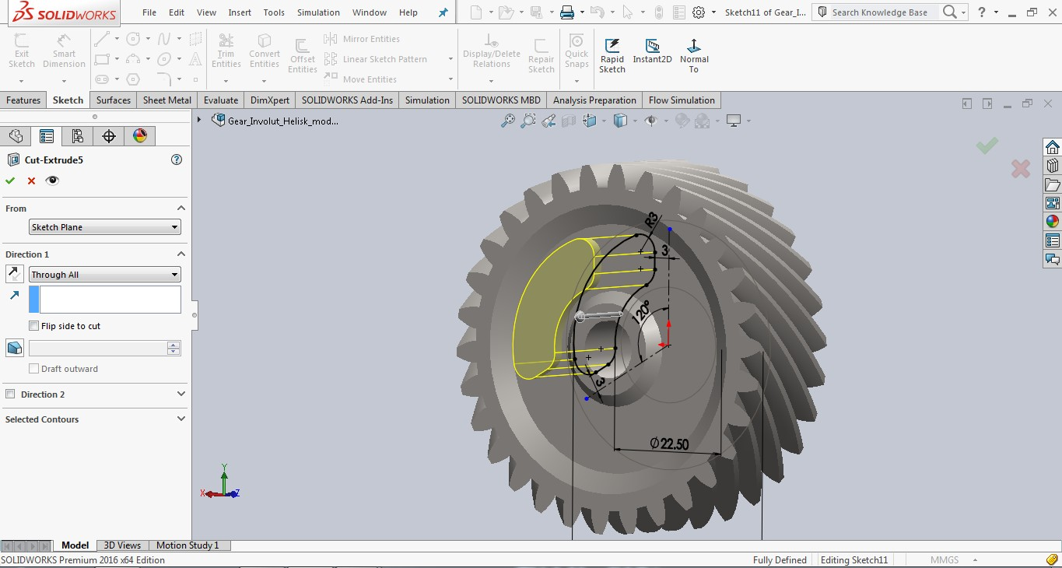
Design And Analysis Of A Helical Gear
Draw a sketch as follows and make another extrude cut for that sketch in features
And make circular pattern for that extrude cut

Slide 30
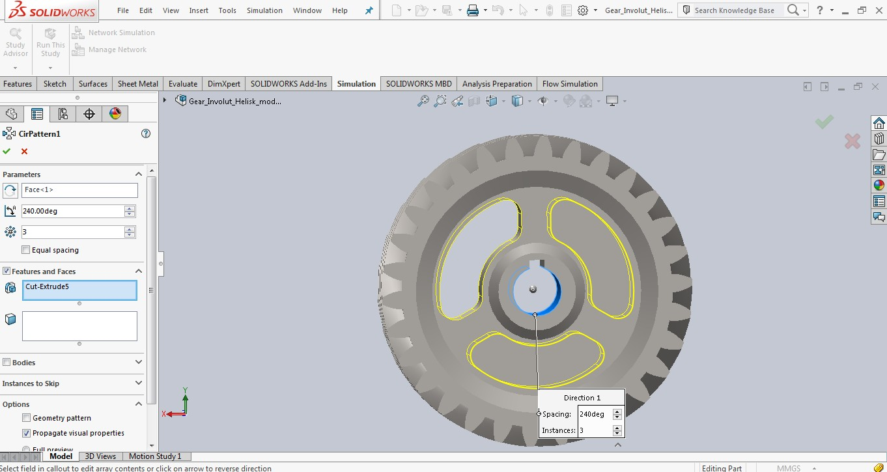
Design And Analysis Of A Helical Gear
Give necessary chamfers and draw a sketch as follows
Then make revolve along that sketch using revolve option in features

Slide 31
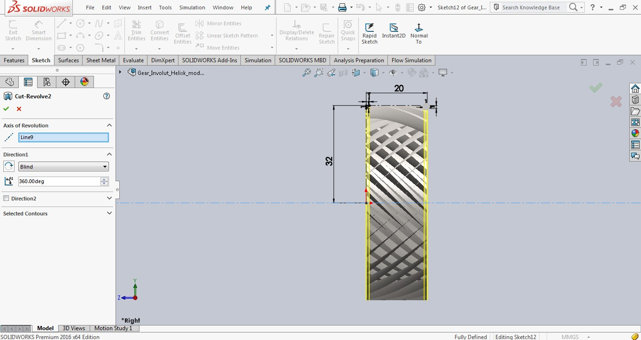
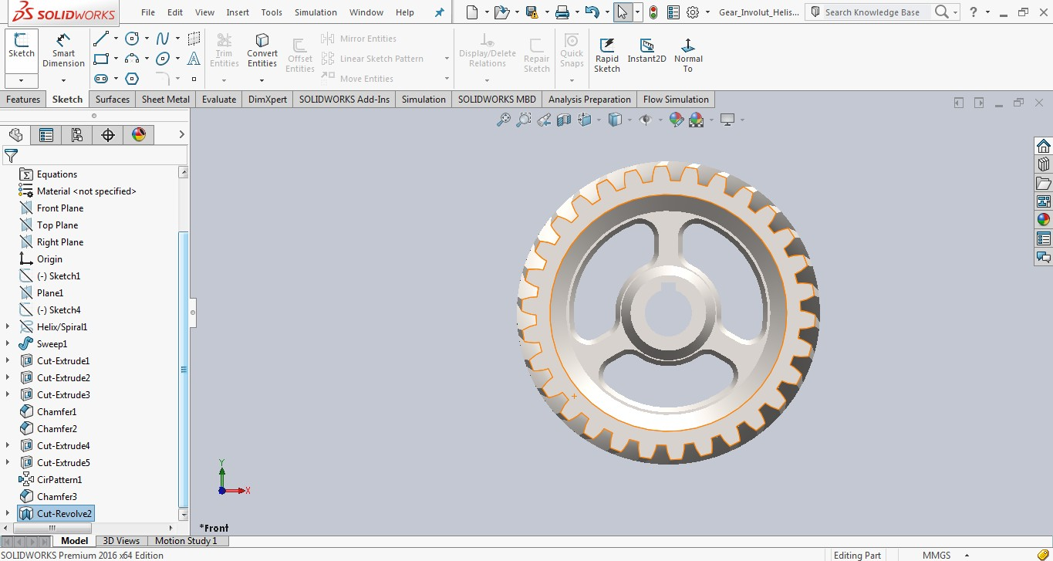
Design And Analysis Of A Helical Gear
Thus helical gear is modeled in solid works using different commands

Slide 32
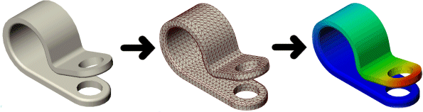
Design And Analysis Of A Helical Gear
CHAPTER 5
INTRODUCTION TO SOLIDWORKS SIMULATION :
SolidWorks® Simulation is a design analysis system fully integrated with SolidWorks. SolidWorks Simulation provides simulation solutions for linear and nonlinear static, frequency, buckling, thermal, fatigue, pressure vessel, drop test, linear and nonlinear dynamic, and optimization analyses.
Powered by fast and accurate solvers, SolidWorks Simulation enables you to solve large problems intuitively while you design. SolidWorks Simulation comes in two bundles: SolidWorks Simulation Professional and SolidWorks Simulation Premium to satisfy your analysis needs. SolidWorks Simulation shortens time to market by saving time and effort in searching for the optimum design.
Figure 46 : simulation example
Benefits of Simulation:
After building your model, you need to make sure that it performs efficiently in the field. In the absence of analysis tools, this task can only be answered by performing expensive and time- consuming product development cycles. A product development cycle typically includes the following steps:
Building your model.
Building a prototype of the design.
Testing the prototype in the field.
Evaluating the results of the field tests.
Modifying the design based on the field test results.

Slide 33
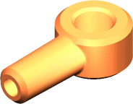
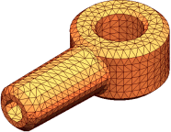
Design And Analysis Of A Helical Gear
This process continues until a satisfactory solution is reached. Analysis can help you accomplish the following tasks:
Reduce cost by simulating the testing of your model on the computer instead of expensive field tests.
Reduce time to market by reducing the number of product development cycles.
Improve products by quickly testing many concepts and scenarios before making a final decision, giving you more time to think of new designs
Basic Concepts of Analysis :
The software uses the Finite Element Method (FEM). FEM is a numerical technique for analyzing engineering designs. FEM is accepted as the standard analysis method due to its generality and suitability for computer implementation. FEM divides the model into many small pieces of simple shapes called elements effectively replacing a complex problem by many simple problems that need to be solved simultaneously.
CAD model of a part | Model subdivided into small pieces (elements)
Elements share common points called nodes. The process of dividing the model into small pieces is called meshing.
The behavior of each element is well-known under all possible support and load scenarios. The finite element method uses elements with different shapes.
The response at any point in an element is interpolated from the response at the element nodes. Each node is fully described by a number of parameters depending on the analysis type and the element used. For example, the temperature of a node fully describes its response in thermal analysis. For structural analyses, the response of a node is described, in general, by three translations and three rotations. These are called degrees of freedom (DOFs). Analysis using FEM is called Finite Element Analysis (FEA).

Slide 34
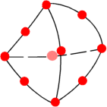
Design And Analysis Of A Helical Gear
A tetrahedral element. Red dots represent nodes. Edges of an element can be curved or straight.
The software formulates the equations governing the behavior of each element taking into consideration its connectivity to other elements. These equations relate the response to known material properties, restraints, and loads.
Next, the program organizes the equations into a large set of simultaneous algebraic equations and solves for the unknowns.
In stress analysis, for example, the solver finds the displacements at each node and then the program calculates strains and finally stresses.
The software offers the following types of studies:
Study type | Study icon
Static |  | Modal Time History
Frequency |  | Harmonic
Buckling |  | Random Vibration
Thermal |  | Response Spectrum
Design Study |  | Drop Test
Nonlinear Static |  | Fatigue
Nonlinear Dynamic |  | Pressure Vessel Design

Slide 35
Design And Analysis Of A Helical Gear
Analysis Steps :
The steps needed to perform an analysis depend on the study type. You complete a study by performing the following steps:
Create a study defining its analysis type and options.
If needed, define parameters of your study. A parameter can be a model dimension, material property, force value, or any other input.
Define material properties.
Specify restraints and loads.
The program automatically creates a mixed mesh when different geometries (solid, shell, structural members etc.) exist in the model.
Define component contact and contact sets.
Mesh the model to divide the model into many small pieces called elements. Fatigue and optimization studies use the meshes in referenced studies.
Run the study.
View results.

Slide 36
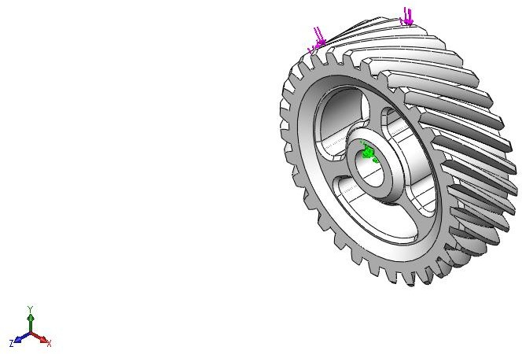
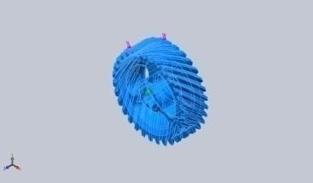
Design And Analysis Of A Helical Gear
Material: aluminum silicon carbide
Load: force: 1000N.
Model Information
Model name: Gear_Involut_Helisk_modsat_med_eger Current Configuration: Default
Solid Bodies
<L_MdInf_SldBd_N m/> | Treated As | Volumetric Properties | Document Path/Date Modified
Cut-Revolve2 | Solid Body | Mass:0.10896 kg Volume:3.78333e-005 m^3 Density:2880 kg/m^3 Weight:1.06781 N | C:\Users\Mech\Deskt op\Gear_Involut_Heli sk_modsat_med_eger .SLDPRT May20 11:05 2022
<L_MdInf_ShlBd_N m/> | <L_MdIn_ShlBd_ Fr/> | <L_MdInf_ShlBd_VolPr op/> | <L_MdIn_ShlBd_Dt Md/>
<L_MdInf_CpBd_N m/> | <L_MdInf_CompBd_Props/>
<L_MdInf_BmBd_N m/> | <L_MdIn_BmBd_ Fr/> | <L_MdInf_BmBd_VolPr op/> | <L_MdIn_BmBd_Dt Md/>

Slide 37
Design And Analysis Of A Helical Gear
Study Properties
Study name | Static 1
Analysis type | Static
Mesh type | Solid Mesh
Thermal Effect: | On
Thermal option | Include temperature loads
Zero strain temperature | 298 Kelvin
Include fluid pressure effects from SOLIDWORKS Flow Simulation | Off
Solver type | FFEPlus
Inplane Effect: | Off
Soft Spring: | Off
Inertial Relief: | Off
Incompatible bonding options | Automatic
Large displacement | Off
Compute free body forces | On
Friction | Off
Use Adaptive Method: | Off
Result folder | SOLIDWORKS document (C:\Users\Mech\Downloads)
Units
Unit system: | SI (MKS)
Length/Displacement | mm
Temperature | Kelvin
Angular velocity | Rad/sec
Pressure/Stress | N/m^2

Slide 38
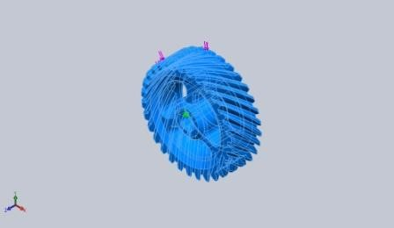
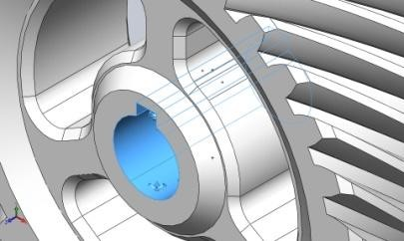
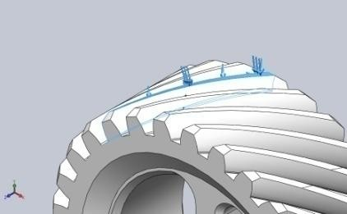
Design And Analysis Of A Helical Gear
Material Properties
Model Reference
Properties
Components
Name: | Al Si C
Model type: | Linear Elastic Isotropic
Default failure criterion: | Max von Mises Stress
Yield strength: | 3.4e+008 N/m^2
Tensile strength: | 6.8e+008 N/m^2
Elastic modulus: | 1.15e+011 N/m^2
Poisson's ratio: | 0.27
Mass density: | 2880 kg/m^3
Shear modulus: | 3.189e+008 N/m^2
SolidBody 1(Cut- Revolve2)(Gear_Involut
_Helisk_modsat_med_eg er)
Curve Data:N/A
Loads and Fixtures
Fixture name |  | Fixture Image |  |  | Fixture Details
Fixed-1 |  |  |  |  | Entities: 4 face(s) Type: Fixed Geometry
 | Resultant Forces
 | Components |  | X | Y |  | Z | Resultant
 | Reaction force(N) |  | -1529.58 | 1740.96 |  | -663.695 | 2410.62
 | Reaction Moment(N.m) |  | 0 | 0 |  | 0 | 0
Load name
Load Image
Load Details
Entities: | 3 face(s)
Type: | Apply normal force
Value: | 1000 N
Force-1

Slide 39
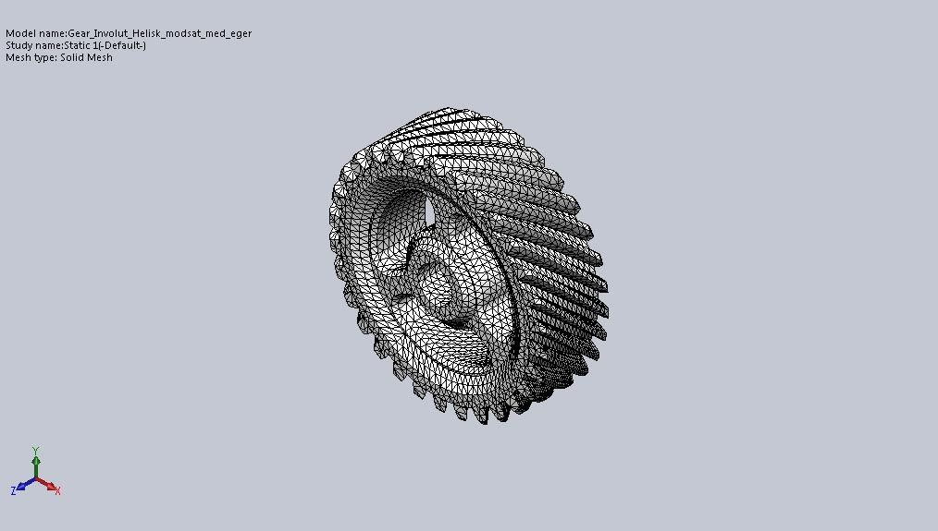
Design And Analysis Of A Helical Gear
Mesh information
Mesh type | Solid Mesh
Mesher Used: | Standard mesh
Automatic Transition: | Off
Include Mesh Auto Loops: | Off
Jacobian points | 4 Points
Element Size | 1.67909 mm
Tolerance | 0.0839547 mm
Mesh Quality | High
Mesh information - Details
Total Nodes | 94385
Total Elements | 59818
Maximum Aspect Ratio | 57.854
% of elements with Aspect Ratio < 3 | 86.4
% of elements with Aspect Ratio > 10 | 0.149
% of distorted elements(Jacobian) | 0
Time to complete mesh(hh;mm;ss): | 00:00:17
Computer name: | MECH-PC

Slide 40
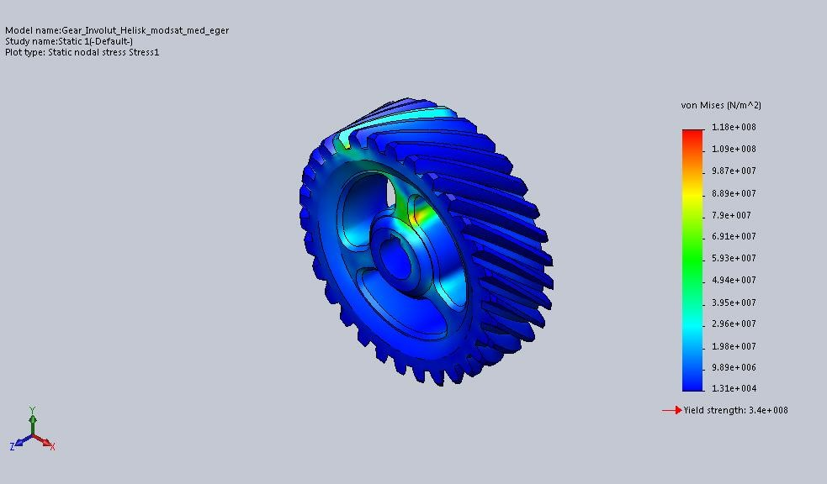
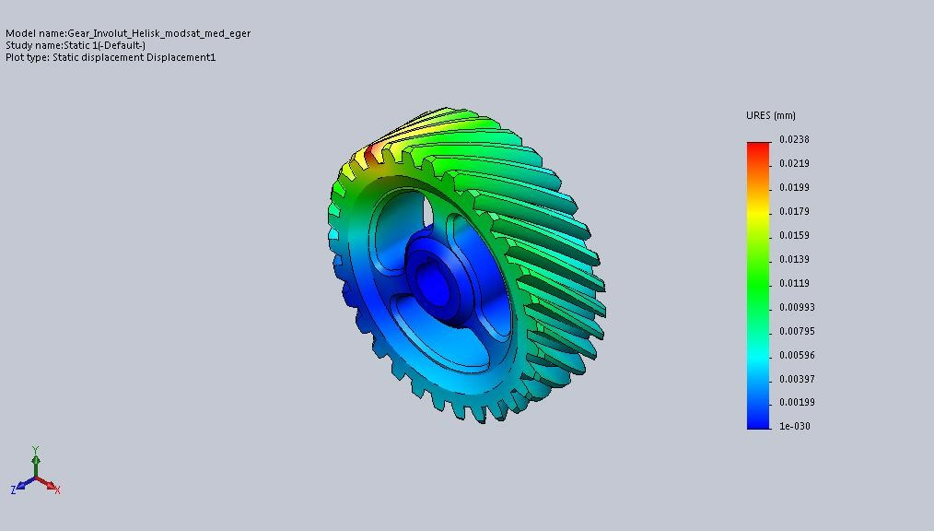
Design And Analysis Of A Helical Gear
Study Results
Name | Type | Min | Max
Stress1 | VON: von Mises Stress | 13081.5 N/m^2 Node: 82238 | 1.18489e+008 N/m^2 Node: 72459
Gear_Involut_Helisk_modsat_med_eger-Static 1-Stress-Stress1
Name | Type | Min | Max
Displacement1 | URES: Resultant Displacement | 0 mm Node: 519 | 0.0238414 mm Node: 3517

Slide 41
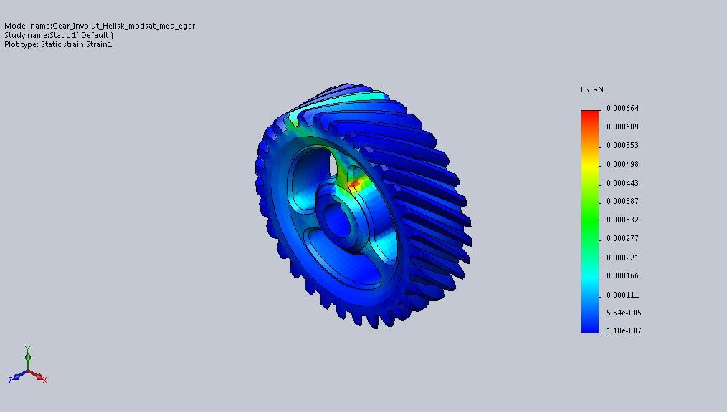
Design And Analysis Of A Helical Gear
Gear_Involut_Helisk_modsat_med_eger-Static 1-Displacement-Displacement1
Name | Type | Min | Max
Strain1 | ESTRN: Equivalent Strain | 1.17757e-007 Element: 31076 | 0.000663873 Element: 20546
Gear_Involut_Helisk_modsat_med_eger-Static 1-Strain-Strain1

Slide 42
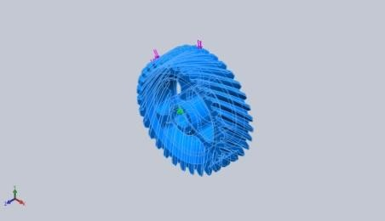
Design And Analysis Of A Helical Gear
Material: GRAY CAST IRON
Load: 1000N Material properties:
Model Reference | Properties | Components
 | Name: Gray Cast Iron Model type: Linear Elastic Isotropic Default failure Mohr-Coulomb criterion: Stress Tensile strength: 1.51658e+008 N/m^2 Compressive 5.72165e+008 strength: N/m^2 Elastic modulus: 6.61781e+010 N/m^2 Poisson's ratio: 0.27 Mass density: 7200 kg/m^3 Shear modulus: 5e+010 N/m^2 Thermal 1.2e-005 /Kelvin expansion coefficient: | SolidBody 1(Cut- Revolve2)(Gear_Involut _Helisk_modsat_med_eg er)
Curve Data:N/A

Slide 43
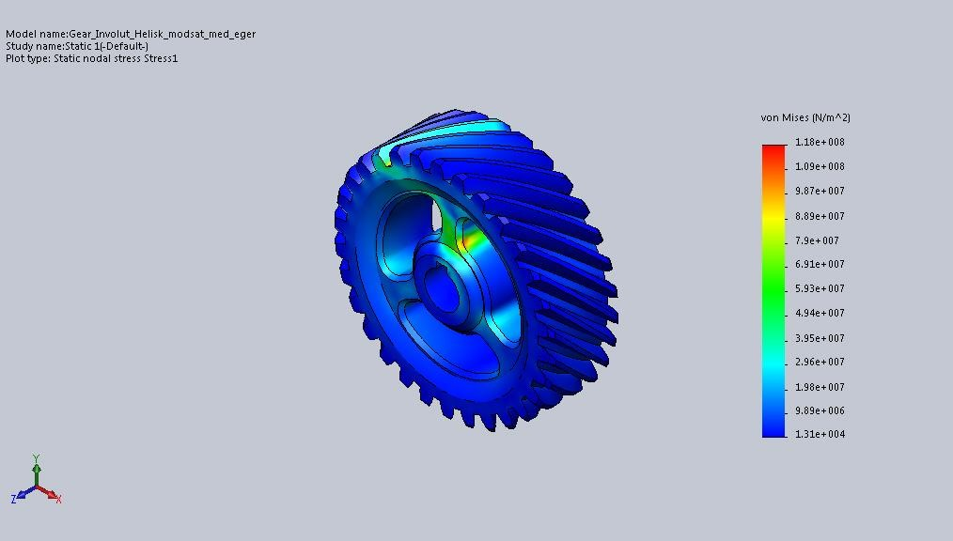
Design And Analysis Of A Helical Gear
Study Results
Name | Type | Min | Max
Stress1 | VON: von Mises Stress | 13081.5 N/m^2 Node: 82238 | 1.18489e+008 N/m^2 Node: 72459
Gear_Involut_Helisk_modsat_med_eger-Static 1-Stress-Stress1
Name | Type | Min | Max
Displacement1 | URES: Resultant Displacement | 0 mm Node: 519 | 0.04143 mm Node: 3517

Slide 44
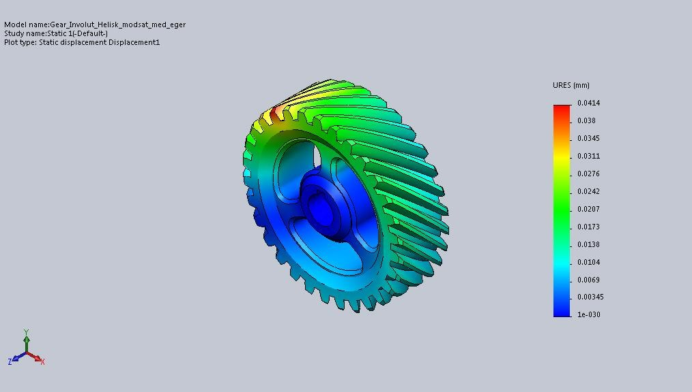

Design And Analysis Of A Helical Gear
Gear_Involut_Helisk_modsat_med_eger-Static 1-Displacement-Displacement1
Name | Type | Min | Max
Strain1 | ESTRN: Equivalent Strain | 2.0463e-007 Element: 31076 | 0.00115364 Element: 20546
Gear_Involut_Helisk_modsat_med_eger-Static 1-Strain-Strain1

Slide 45

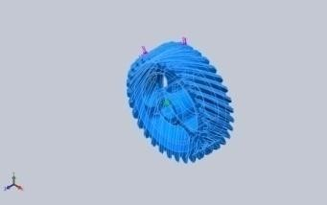
Design And Analysis Of A Helical Gear
Load: 1500N
Material: ALUMINIUM SILICON CARBIDE
Model Information
Model name: Gear_Involut_Helisk_modsat_med_eger Current Configuration: Default
Solid Bodies
<L_MdInf_SldBd_ Nm/> | Treated As | Volumetric Properties | Document Path/Date Modified
Cut-Revolve2 | Solid Body | Mass:0.10896 kg Volume:3.78333e-005 m^3 Density:2880 kg/m^3 Weight:1.06781 N | C:\Users\Mech\Des ktop\Gear_Involut_ Helisk_modsat_med _eger.SLDPRT May 20 11:10:50 2022
<L_MdInf_ShlBd_ Nm/> | <L_MdIn_ShlBd _Fr/> | <L_MdInf_ShlBd_Vol Prop/> | <L_MdIn_ShlBd_D tMd/>
<L_MdInf_CpBd_ Nm/> | <L_MdInf_CompBd_Props/>
<L_MdInf_BmBd_ Nm/> | <L_MdIn_BmBd _Fr/> | <L_MdInf_BmBd_Vol Prop/> | <L_MdIn_BmBd_D tMd/>

Slide 46
Design And Analysis Of A Helical Gear
Study Properties
Study name | Static 1
Analysis type | Static
Mesh type | Solid Mesh
Thermal Effect: | On
Thermal option | Include temperature loads
Zero strain temperature | 298 Kelvin
Include fluid pressure effects from SOLIDWORKS Flow Simulation | Off
Solver type | FFEPlus
Inplane Effect: | Off
Soft Spring: | Off
Inertial Relief: | Off
Incompatible bonding options | Automatic
Large displacement | Off
Compute free body forces | On
Friction | Off
Use Adaptive Method: | Off
Result folder | SOLIDWORKS document (C:\Users\Mech\Downloads)
Units
Unit system: | SI (MKS)
Length/Displacement | mm
Temperature | Kelvin
Angular velocity | Rad/sec
Pressure/Stress | N/m^2

Slide 47


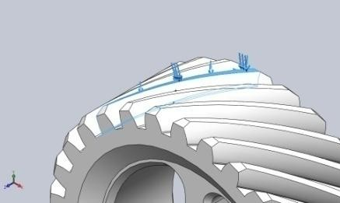
Design And Analysis Of A Helical Gear
Material Properties
Model Reference | Properties | Components
 | Name: Al Si C Model type: Linear Elastic Isotropic Default failure Max von Mises criterion: Stress Yield strength: 3.4e+008 N/m^2 Tensile strength: 6.8e+008 N/m^2 Elastic modulus: 1.15e+011 N/m^2 Poisson's ratio: 0.27 Mass density: 2880 kg/m^3 Shear modulus: 3.189e+008 N/m^2 | Solid Body 1(Cut- Revolve2)
Curve Data:N/A
Loads and Fixtures
Fixture name |  | Fixture Image |  | Fixture Details
Fixed-1 |  |  |  | Entities: 4 face(s) Type: Fixed Geometry
 | Resultant Forces
 | Components |  | X | Y | Z | Resultant
 | Reaction force(N) |  | -2294.37 | 2611.44 | -995.543 | 3615.92
 | Reaction Moment(N.m) |  | 0 | 0 | 0 | 0
Load name | Load Image | Load Details
Force-1 |  | Entities: 3 face(s) Type: Apply normal force Value: 1500 N

Slide 48
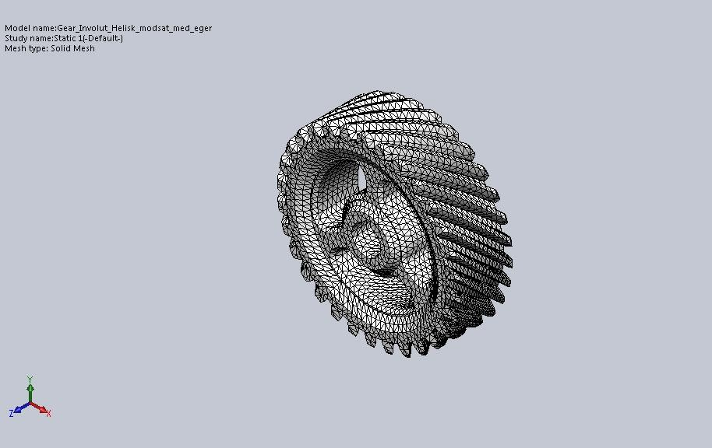
Design And Analysis Of A Helical Gear
Mesh information
Mesh type | Solid Mesh
Mesher Used: | Standard mesh
Automatic Transition: | Off
Include Mesh Auto Loops: | Off
Jacobian points | 4 Points
Element Size | 1.67909 mm
Tolerance | 0.0839547 mm
Mesh Quality | High
Mesh information - Details
Total Nodes | 94385
Total Elements | 59818
Maximum Aspect Ratio | 57.854
% of elements with Aspect Ratio < 3 | 86.4
% of elements with Aspect Ratio > 10 | 0.149
% of distorted elements(Jacobian) | 0
Time to complete mesh(hh;mm;ss): | 00:00:17
Computer name: | MECH-PC

Slide 49
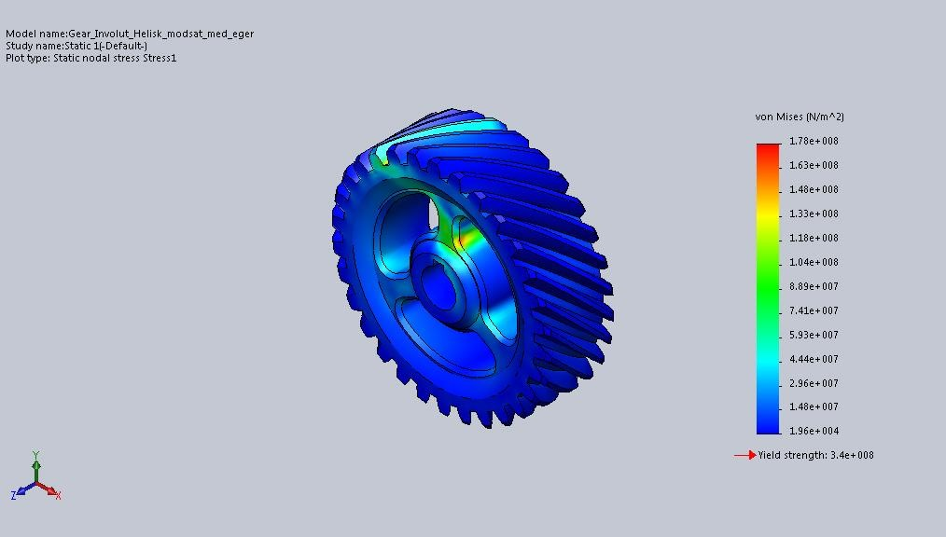
Design And Analysis Of A Helical Gear
Study Results
Name | Type | Min | Max
Stress1 | VON: von Mises Stress | 19622.2 N/m^2 Node: 82238 | 1.77733e+008 N/m^2 Node: 72459
Gear_Involut_Helisk_modsat_med_eger-Static 1-Stress-Stress1
Name | Type | Min | Max
Displacement1 | URES: Resultant Displacement | 0 mm Node: 519 | 0.0357621 mm Node: 3517

Slide 50


Design And Analysis Of A Helical Gear
Gear_Involut_Helisk_modsat_med_eger-Static 1-Displacement-Displacement1
Name | Type | Min | Max
Strain1 | ESTRN: Equivalent Strain | 1.76635e-007 Element: 31076 | 0.00099581 Element: 20546
Gear_Involut_Helisk_modsat_med_eger-Static 1-Strain-Strain1

Slide 51

Design And Analysis Of A Helical Gear
Material: GRAY CAST IRON
Study Results
Name | Type | Min | Max
Stress1 | VON: von Mises Stress | 19622.2 N/m^2 Node: 82238 | 1.77733e+008 N/m^2 Node: 72459
Gear_Involut_Helisk_modsat_med_eger-Static 1-Stress-Stress1
Name | Type | Min | Max
Displacement1 | URES: Resultant Displacement | 0 mm Node: 519 | 0.062145 mm Node: 3517

Slide 52


Design And Analysis Of A Helical Gear
Gear_Involut_Helisk_modsat_med_eger-Static 1-Displacement-Displacement1
Name | Type | Min | Max
Strain1 | ESTRN: Equivalent Strain | 3.06945e-007 Element: 31076 | 0.00173045 Element: 20546
Gear_Involut_Helisk_modsat_med_eger-Static 1-Strain-Strain1

Slide 53

Design And Analysis Of A Helical Gear
Load: 2000N
Material: ALUMINIUM SILICON CARBID
Study Results
Name | Type | Min | Max
Stress1 | VON: von Mises Stress | 26163 N/m^2 Node: 82238 | 2.36977e+008 N/m^2 Node: 72459
Gear_Involut_Helisk_modsat_med_eger-Static 1-Stress-Stress1
Name | Type | Min | Max
Displacement1 | URES: Resultant Displacement | 0 mm Node: 519 | 0.0476827 mm Node: 3517

Slide 54


Design And Analysis Of A Helical Gear
Gear_Involut_Helisk_modsat_med_eger-Static 1-Displacement-Displacement1
Name | Type | Min | Max
Strain1 | ESTRN: Equivalent Strain | 2.35513e-007 Element: 31076 | 0.00132775 Element: 20546
Gear_Involut_Helisk_modsat_med_eger-Static 1-Strain-Strain1

Slide 55
Design And Analysis Of A Helical Gear
Table of Results:
At applied load of 1000N
Material | Strain (N/mm^2) | Deformation (mm) | strain
Aluminium silicon carbide | 1.18489e+008 | 0.0238414 | 0.000663873
Gray cast iron | 1.18489e+008 | 0.04143 | 0.00115364
At applied load of 1500N
Material | Strain (N/mm^2) | Deformation (mm) | strain
Aluminium silicon carbide | 1.77733e+008 | 0.0357621 | 0.00099581
Gray cast iron | 1.77733e+008 | 0.062145 | 0.00173045
At applied load of 2000N
Material | Strain (N/mm^2) | Deformation (mm) | strain
Aluminium silicon carbide | 2.36977e+008 | 0.0476827 | 0.00132775
Gray cast iron | 2.36977e+008 | 0.08286 | 0.00230727

Slide 56
Design And Analysis Of A Helical Gear
Conclusion:
Modeling and analysis of helical gear is done in solid works
Helical gear is designed by using various commands in solid works
Static analysis is done on helical gear in solid works simulation tool
Different materials at different loads are applied and stress, strain and displacement values are analyzed
The stress, strain and displacement values for different materials at different loads are noted and tabulated
From the results aluminum silicon carbide are more preferable when compared to grey cast iron because at a given load it is showing breakage.

